Slide 1



UK Online Retails Store Report
View in Power BI
Last data refresh:
8/9/2024 11:02:49 PM UTC
Downloaded at:
8/9/2024 11:19:11 PM UTC

Slide 2
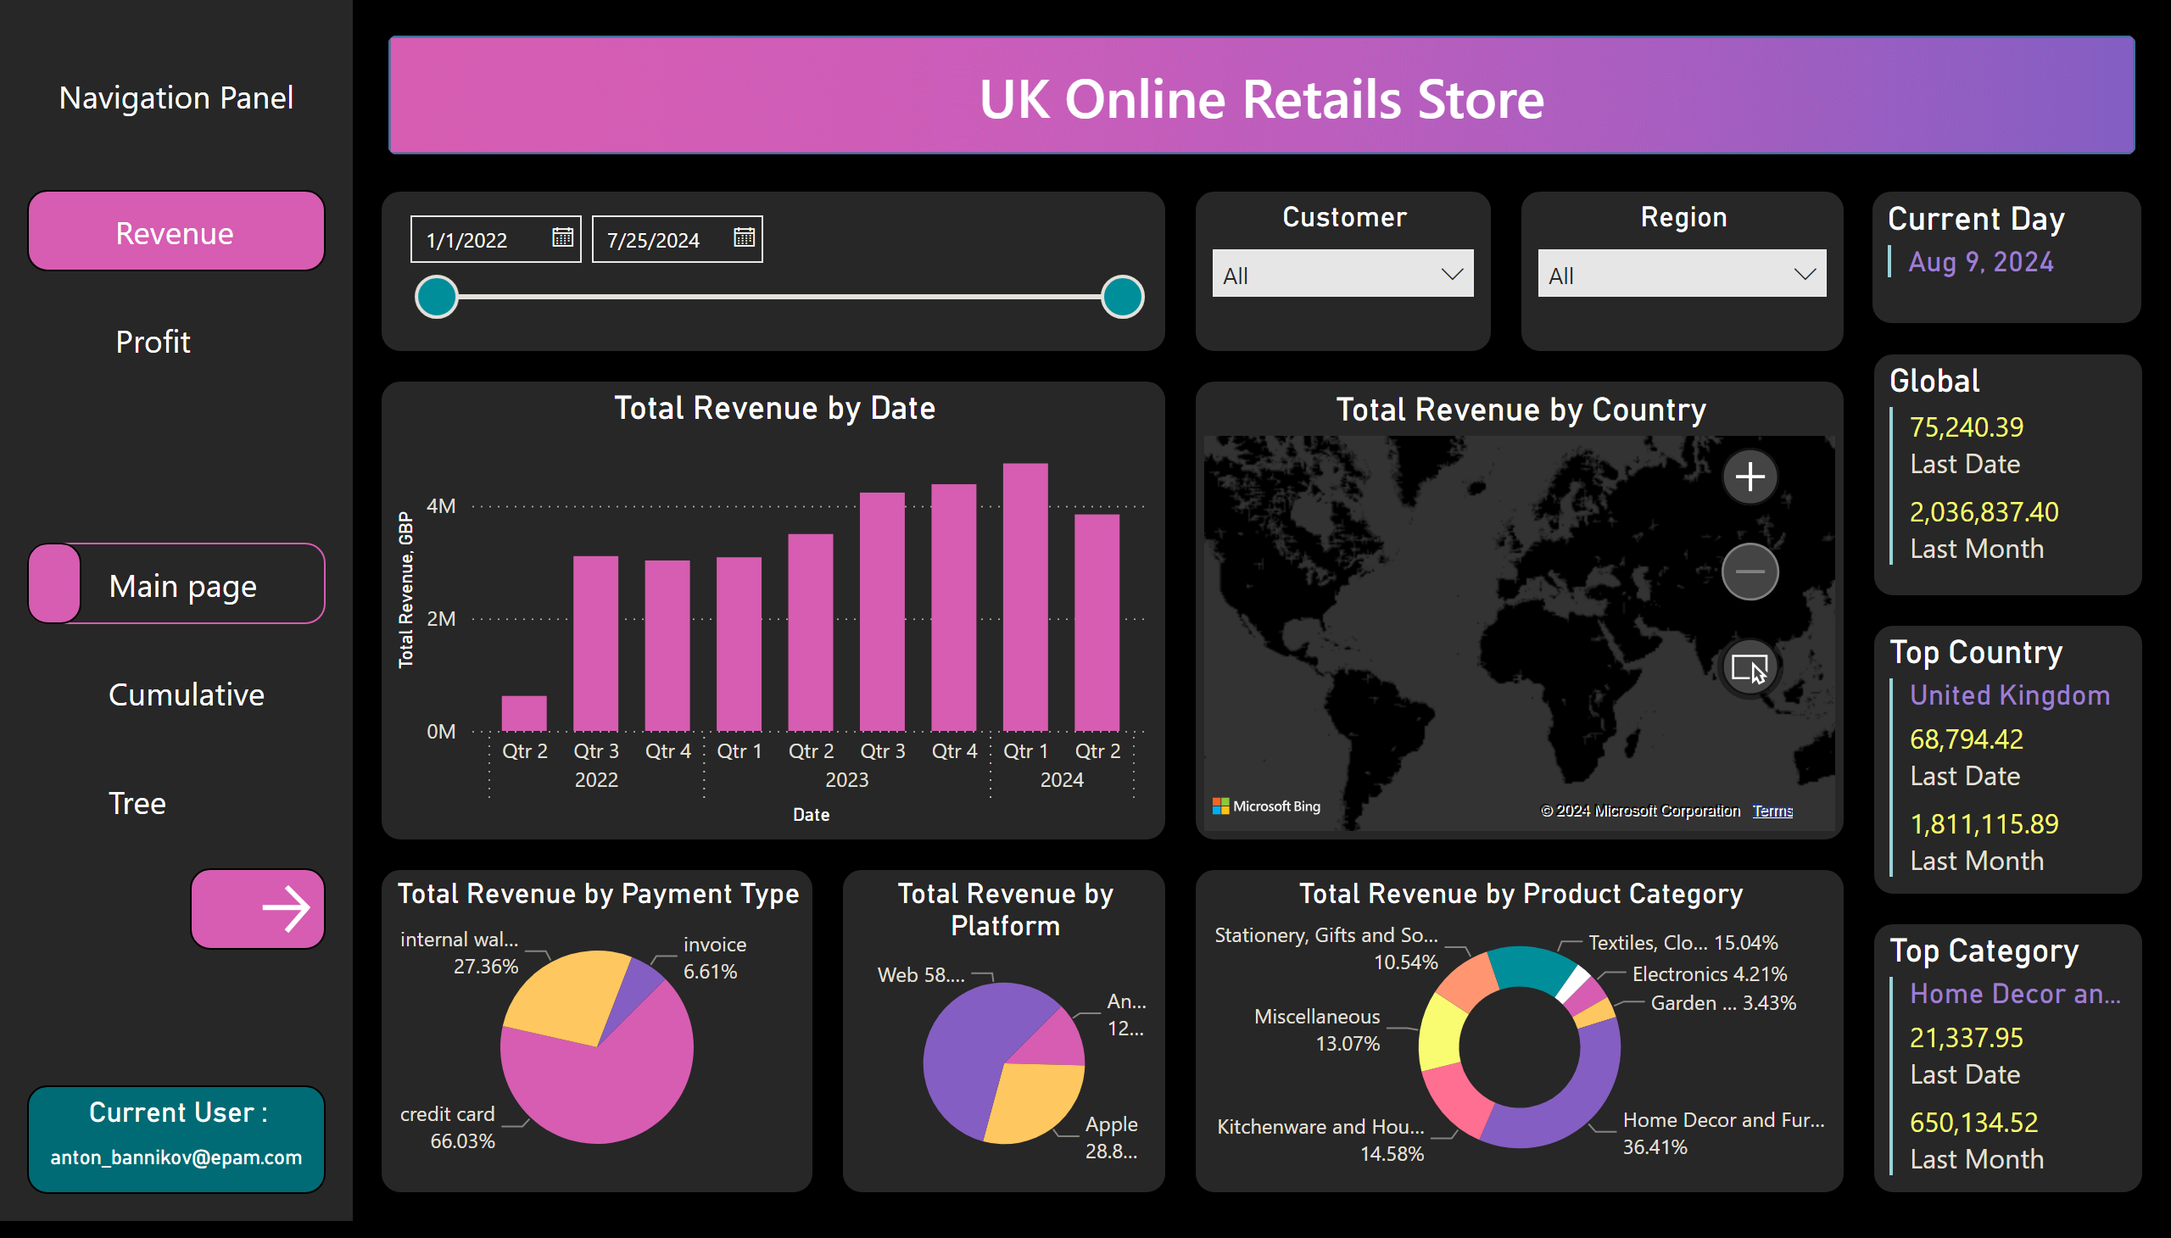
Main Page
Notes:
shape
No alt text provided
actionButton
No alt text provided
Total Revenue by Date
No alt text provided
Total Revenue by Country
No alt text provided
Customer
No alt text provided
slicer
No alt text provided
Total Revenue by Product Category
No alt text provided
Total Revenue by Platform
No alt text provided
Total Revenue by Payment Type
No alt text provided
Global
No alt text provided
Top Country
No alt text provided
Region
No alt text provided
Current Day
No alt text provided
Top Category
No alt text provided
Current User :
No alt text provided
shape
No alt text provided
actionButton
No alt text provided
shape
No alt text provided
shape
No alt text provided
columnChart
No alt text provided
map
No alt text provided
donutChart
No alt text provided
pieChart
No alt text provided
pieChart
No alt text provided
multiRowCard
No alt text provided
multiRowCard
No alt text provided
multiRowCard
No alt text provided
shape
No alt text provided
shape
No alt text provided
shape
No alt text provided
shape
No alt text provided
shape
No alt text provided
shape
No alt text provided
shape
No alt text provided
shape
No alt text provided
shape
No alt text provided
actionButton
No alt text provided
actionButton
No alt text provided
actionButton
No alt text provided
image
No alt text provided

Slide 3
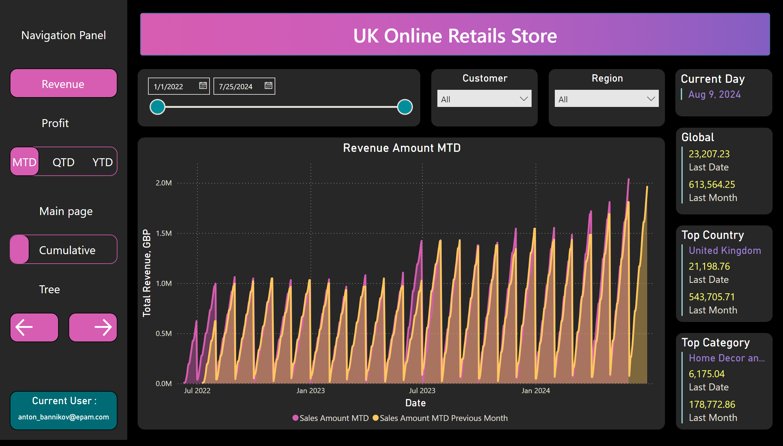
Cumulative
Notes:
shape
No alt text provided
actionButton
No alt text provided
columnChart
No alt text provided
map
No alt text provided
Customer
No alt text provided
slicer
No alt text provided
donutChart
No alt text provided
pieChart
No alt text provided
pieChart
No alt text provided
multiRowCard
No alt text provided
multiRowCard
No alt text provided
Region
No alt text provided
Current Day
No alt text provided
multiRowCard
No alt text provided
Current User :
No alt text provided
shape
No alt text provided
actionButton
No alt text provided
shape
No alt text provided
shape
No alt text provided
Global
No alt text provided
Top Country
No alt text provided
Top Category
No alt text provided
shape
No alt text provided
shape
No alt text provided
shape
No alt text provided
shape
No alt text provided
shape
No alt text provided
shape
No alt text provided
shape
No alt text provided
shape
No alt text provided
shape
No alt text provided
actionButton
No alt text provided
actionButton
No alt text provided
Profit Amount YTD
No alt text provided
shape
No alt text provided
shape
No alt text provided
shape
No alt text provided
shape
No alt text provided
shape
No alt text provided
shape
No alt text provided
shape
No alt text provided
shape
No alt text provided
shape
No alt text provided
lineChart
No alt text provided
lineChart
No alt text provided
lineChart
No alt text provided
lineChart
No alt text provided
lineChart
No alt text provided
Revenue Amount MTD
No alt text provided
shape
No alt text provided
actionButton
No alt text provided
image
No alt text provided

Slide 4
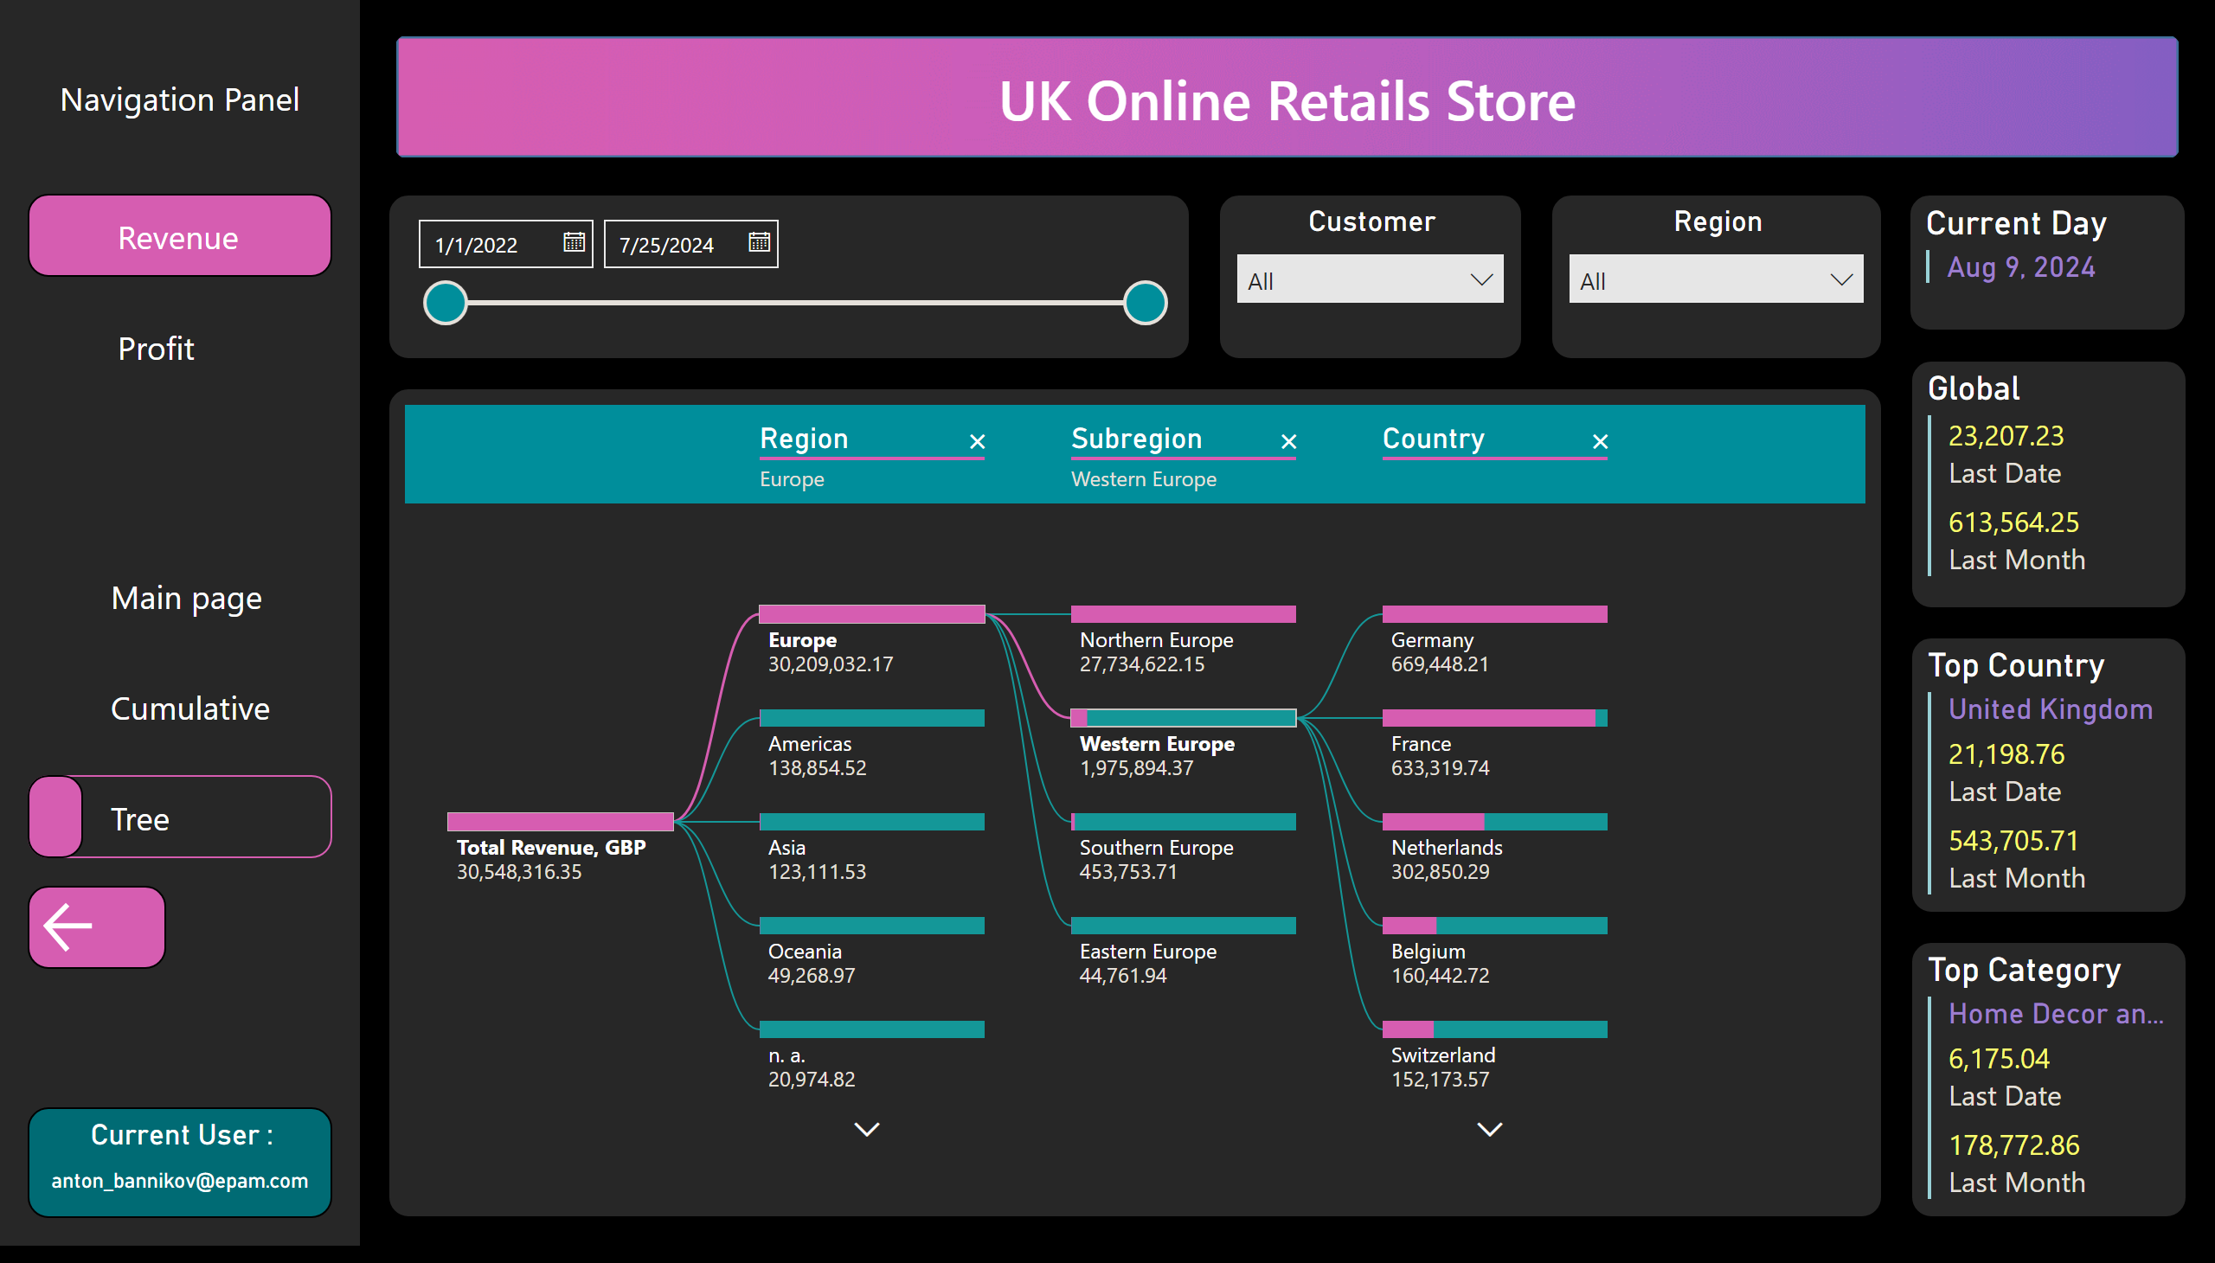
Decomposition Tree
Notes:
shape
No alt text provided
actionButton
No alt text provided
columnChart
No alt text provided
map
No alt text provided
Customer
No alt text provided
slicer
No alt text provided
donutChart
No alt text provided
pieChart
No alt text provided
pieChart
No alt text provided
multiRowCard
No alt text provided
multiRowCard
No alt text provided
Region
No alt text provided
Current Day
No alt text provided
multiRowCard
No alt text provided
Current User :
No alt text provided
shape
No alt text provided
actionButton
No alt text provided
shape
No alt text provided
shape
No alt text provided
Global
No alt text provided
Top Country
No alt text provided
Top Category
No alt text provided
shape
No alt text provided
shape
No alt text provided
shape
No alt text provided
shape
No alt text provided
shape
No alt text provided
shape
No alt text provided
shape
No alt text provided
shape
No alt text provided
shape
No alt text provided
actionButton
No alt text provided
actionButton
No alt text provided
decompositionTreeVisual
No alt text provided
decompositionTreeVisual
No alt text provided
actionButton
No alt text provided
image
No alt text provided

